Slide 1
pollution
Submitted by gayatri

Slide 2
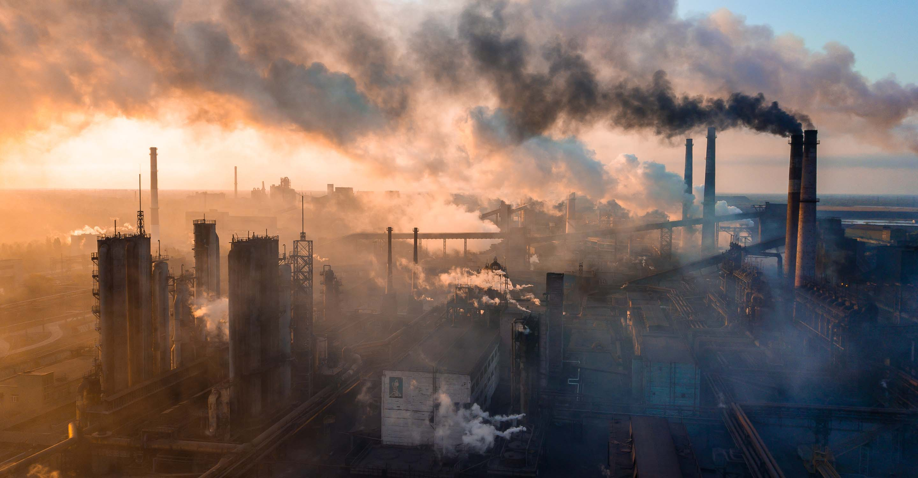
We have got only one earth ……..

Slide 3
overview
Definition of pollution
Types of pollution
Air pollution
a. introduction b. Effects
c. causes d. prevention
Water pollution
a. introduction b. Effects
c. causes d. prevention

Slide 4
air pollution
Air pollution can be defined as an alteration of air quality that can be characterized by measurements of chemical, biological or physical pollutants in the air. Therefore, air pollution means the undesirable presence of impurities or the abnormal rise in the proportion of some constituents of the atmosphere. It can be classified in 2 sections: visible and invisible air pollution.
Local
this concerns the quality of ambient air within a radius of a few kilometers
Regional
pollution like acid rain, photochemical reactions and degradation of water quality at distances of a few kilometers to a thousand kilometers
Global
depletion of the ozone layer and global warming caused by the emission of greenhouse gases, mainly carbon dioxide (CO2)

Slide 5
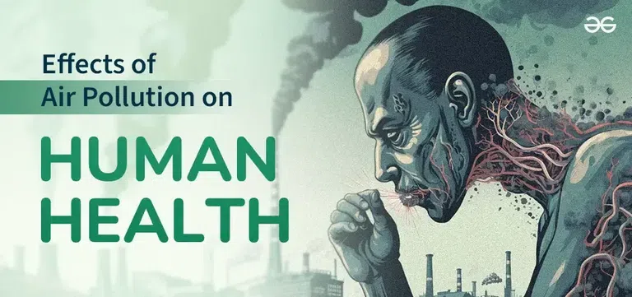

Slide 6
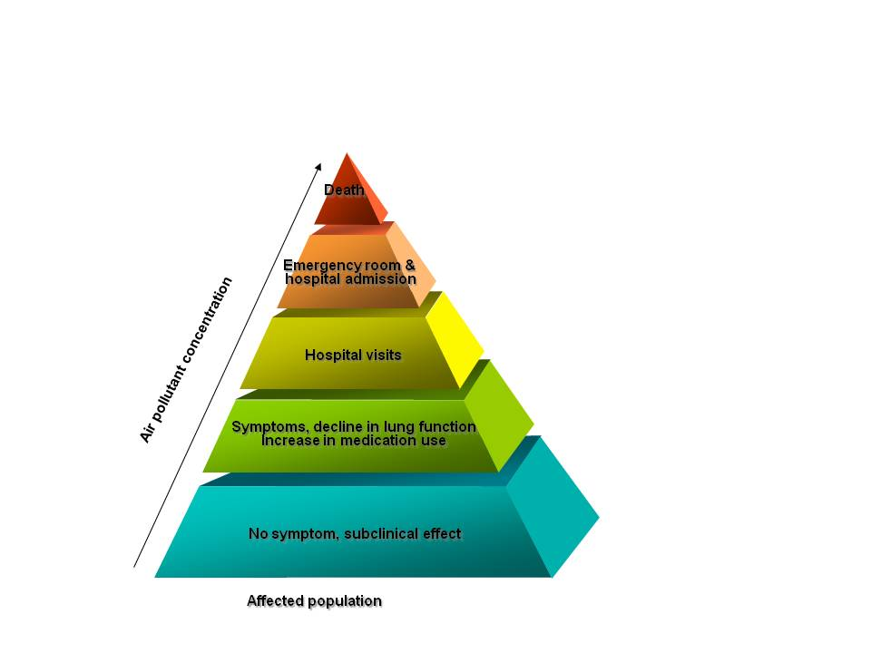
Effects of air polltion
Air pollution causes a variety of health problems , including : respiratory infections, heart disease , lung cancer , premature mortality , stroke , asthama .

Slide 7
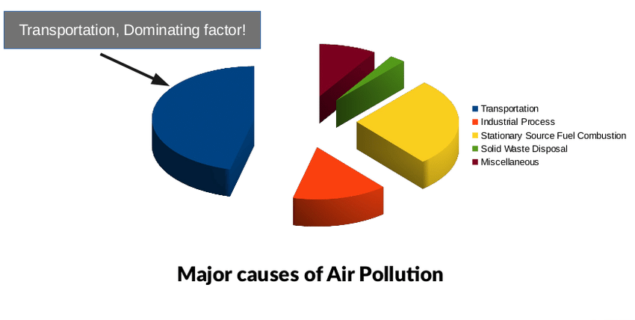
Causes

Slide 8
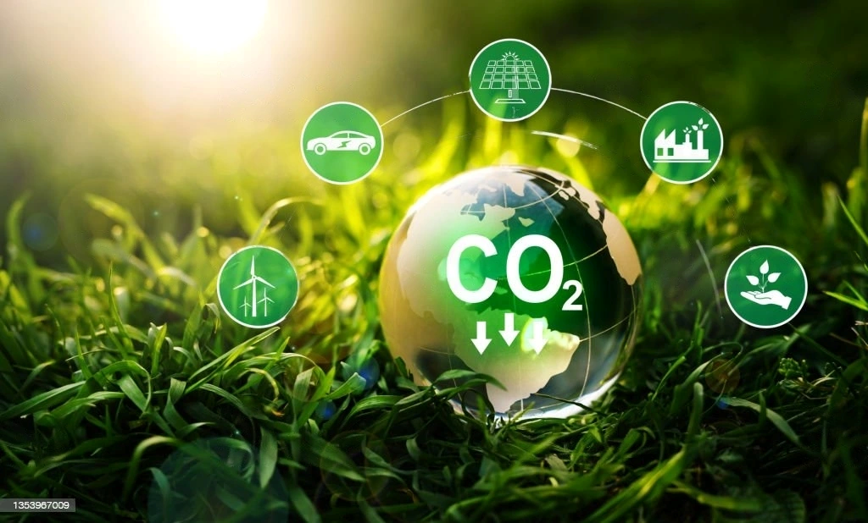


Prevention
Stop the wastage of energy ,transportation,reduce forest fires and smoking ,recycle and reuse products , cutting down emissions from power plant and adopting more sustainable approach to agriculture .
prevention

Slide 9
Prevention
Stop the wastage of energy ,transportation,reduce forest fires and smoking ,recycle and reuse products , cutting down emissions from power plant and adopting more sustainable approach to agriculture .
prevention

Slide 10


